Slide 1
The role of climate on large fire events in the Western Cape
Dr. Danie Boshoff
Senior Lecturer: Geography
danie.boshoff@nwu.ac.za

Slide 2
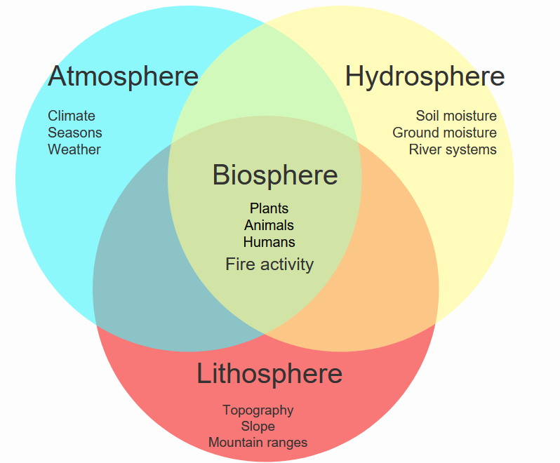
Introduction

Slide 3
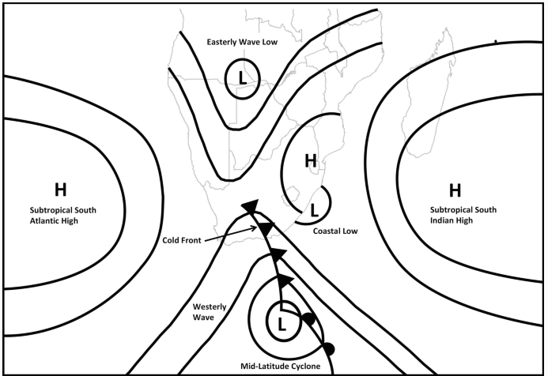
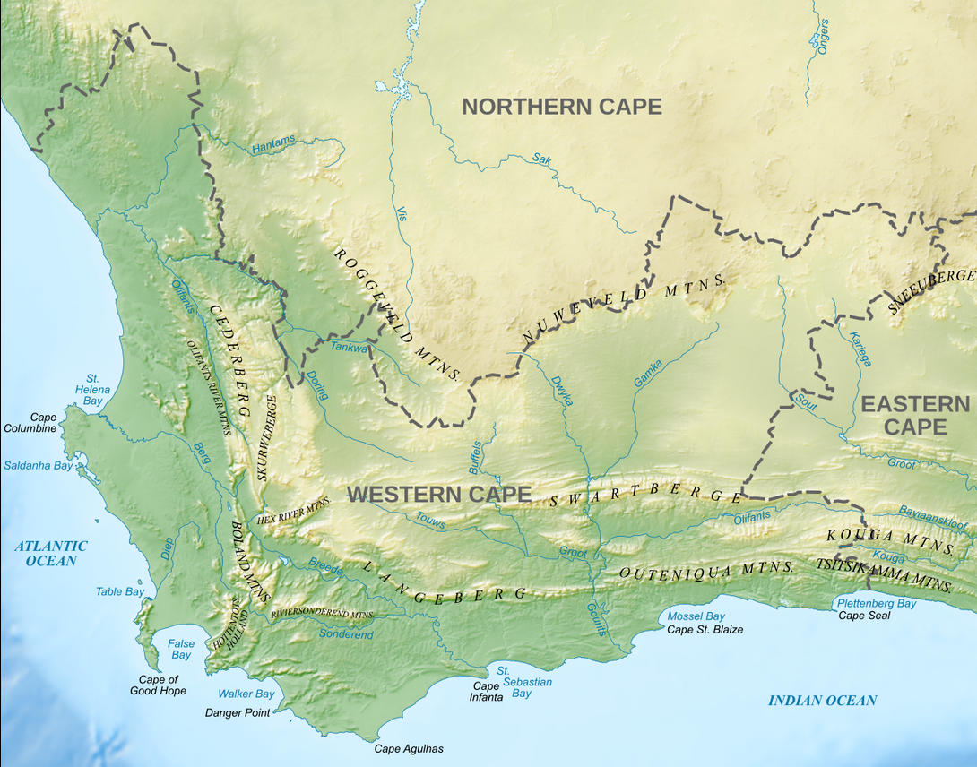
Introduction
Notes:
). Ridging HPs are responsible for almost half of the annual rainfall along the south coast of the Eastern and Western Cape Provinces of South Africa (Engelbrecht et al 2015; Pohl et al., 2018). The western parts of southern Africa are often subjected to regional scale synoptic systems formed in the subpolar LP. One of the most common systems is a cut-off low (COL). COLs have the ability to produce large amounts of precipitation, which can lead to flash flooding (Singleton and Reason, 2006). In South Africa, the winter rainfall zone as well as the southern Cape region receive the majority of its precipitation from ridging HPs and COLs (Engelbrecht and Landman, 2016).

Slide 4
Introduction
Teleconnections like El Niño Southern Oscillation (ENSO) and the Southern Annular Mode (SAM) exert significant influence on fire seasons - which can to an uptick in large fires during dry and warm periods.
Future predictions: rising temperatures and less precipitation in the southwestern regions of Africa, increase in heatwave frequency and high-fire danger days (Engelbrecht and Monteiro 2021).

Slide 5
Methods
CapeNature data: generate a map displaying the geographical distribution of the 15 largest fire incidents in the Western Cape spanning from 1927 to 2021.
Precipitation anomalies were visualized using the IRI Climate Lab interactive tools.
European Centre for Medium-Range Weather Forecasts (ECMWF) ERA5 climate reanalysis datasets were used to plot and display ENSO (SOI) and SAM phases via the KMNI Climate Explorer

Slide 6
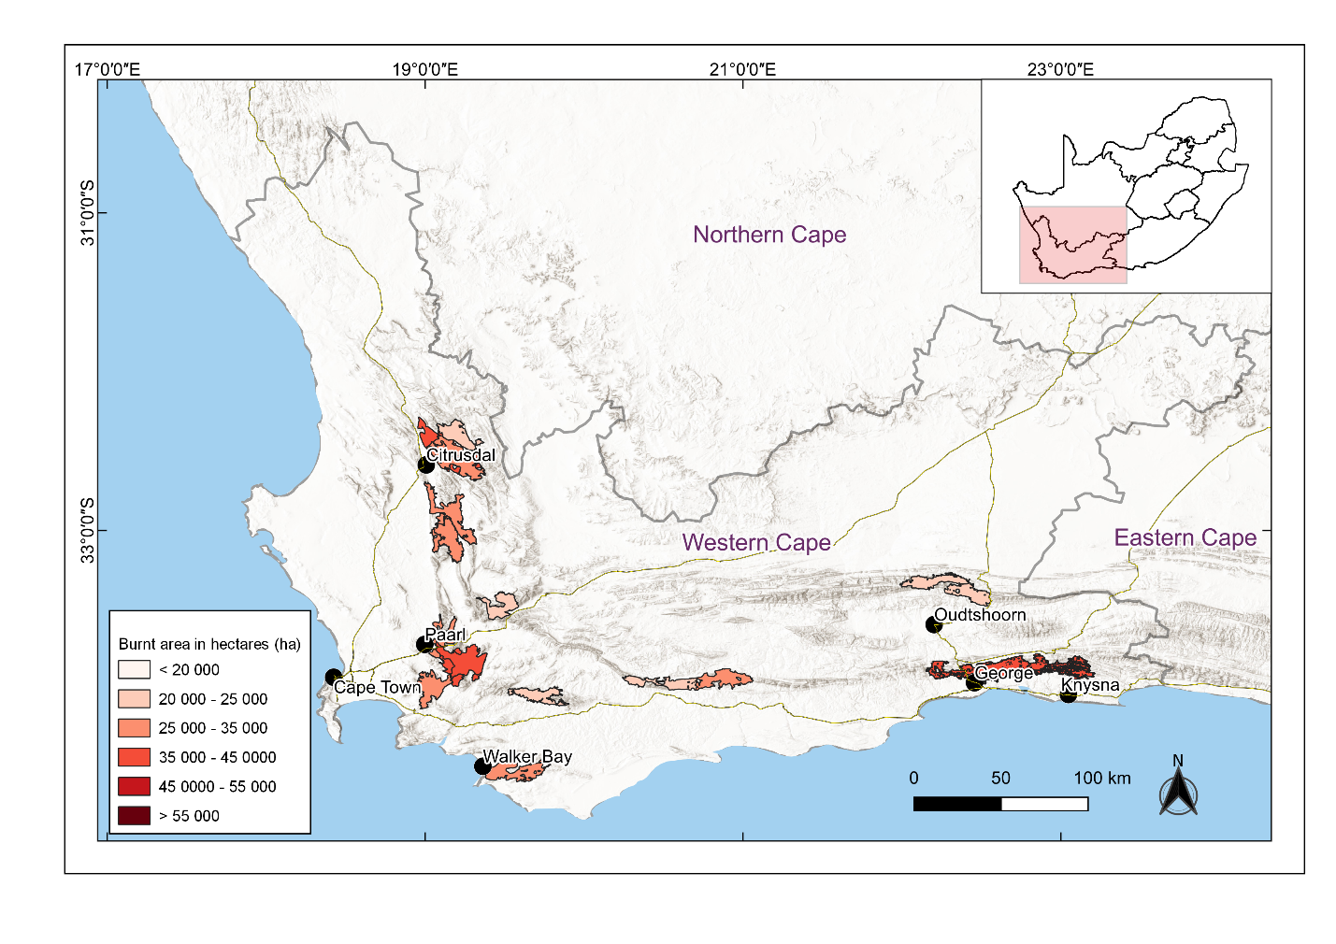
Results

Slide 7
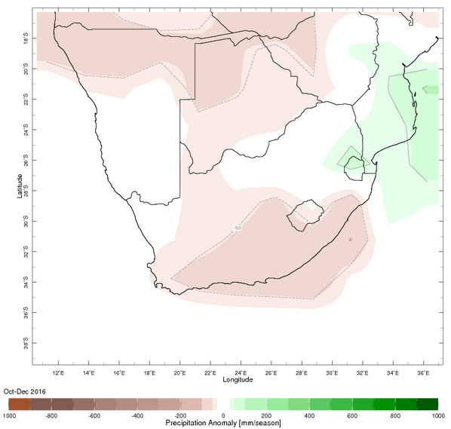
Results

Slide 8
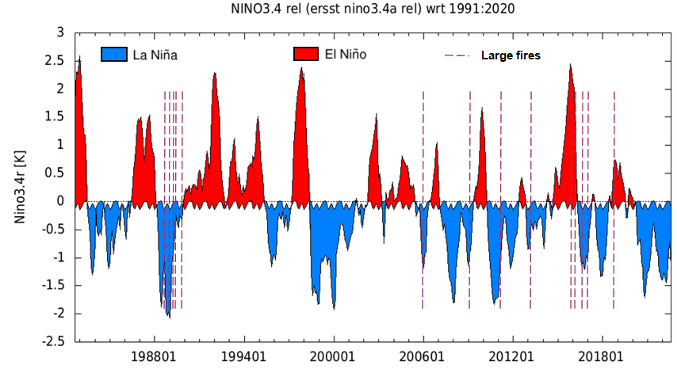
Results

Slide 9
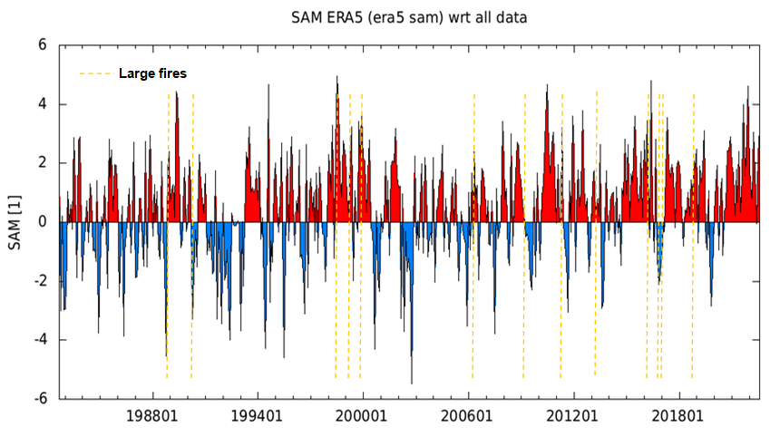
Results

Slide 10
Conclusion
In the Western Cape, more than half of the largest fire events occurred in the years following the El Niño phase of ENSO, positive phase of SAM (66%) and below normal seasonal precipitation anomalies (66%).
Only 27% of the large fire events occurred after La Niña phases of ENSO, negative phases of SAM and below normal seasonal precipitation anomalies.

