Slide 1




WORKING ON FIRE
20th Anniversary Fire Symposium
Analyzing interactions between landscape structure and fire-resilience at watershed level, experiences from Ankarafantsika National Park, Madagascar
Gaston Hedwigino Tahintsoa
Researcher, Regional Eastern Africa Fire Management Resource Center (REA-FMRC) Antananarivo, Madagascar

Slide 2
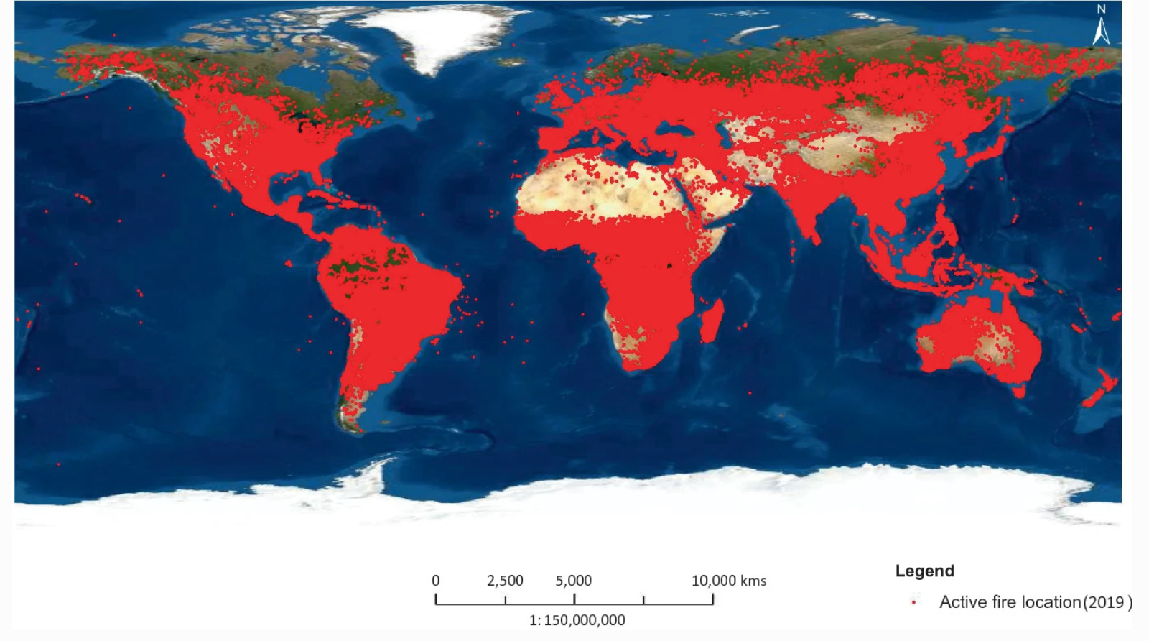
Fires across the world
Global distribution of active fires from January to December 2019, as detected by MODIS (Thapa et al., 2021).

Slide 3

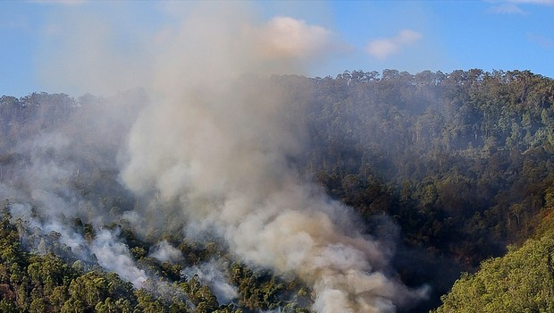

Madagascar…
Veritable nature sanctuary : 5% of the planet's plant and animal species are found in Madagascar, with an endemicity rate approaching 80%.
Biodiversity hotspots : recurrence of wildfire
Limits of fire suppression-centered strategies have become evident, especially in underdeveloped and technologically less equipped countries such as Madagascar due to limited budget allocation.
Concept of fire resilience has become increasingly relevant

Slide 4
Fire resilient landscape
Landscape designed and managed to reduce the risk of wildfires and minimize their impact on the environment, biodiversity, people life and health and property : Fire-Resistant Plants, firebreaks, fuelbreaks,…
Homogeneous landscape refers to an environment or area where the physical and ecological characteristics are relatively uniform and consistent.
Heterogeneous landscape is characterized by a significant diversity of physical and ecological features, with various elements and patterns that differ from one another (topography, land cover, vegetation…).

Slide 5
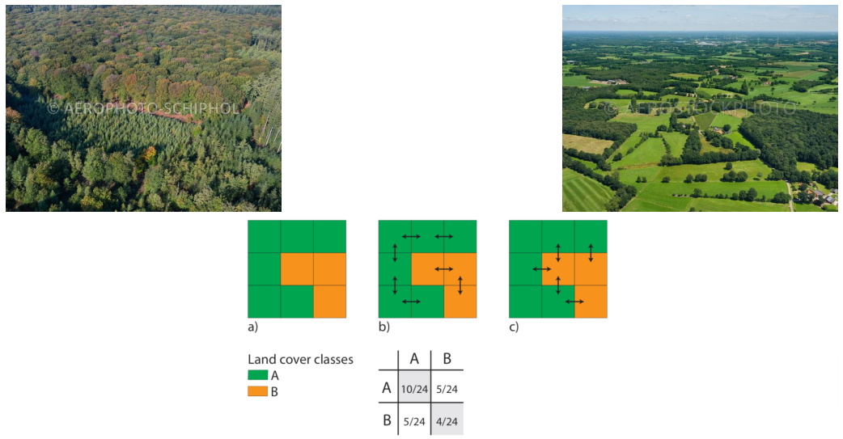
Landscape spatial structure
How does landscape structure affect fire?

Slide 6
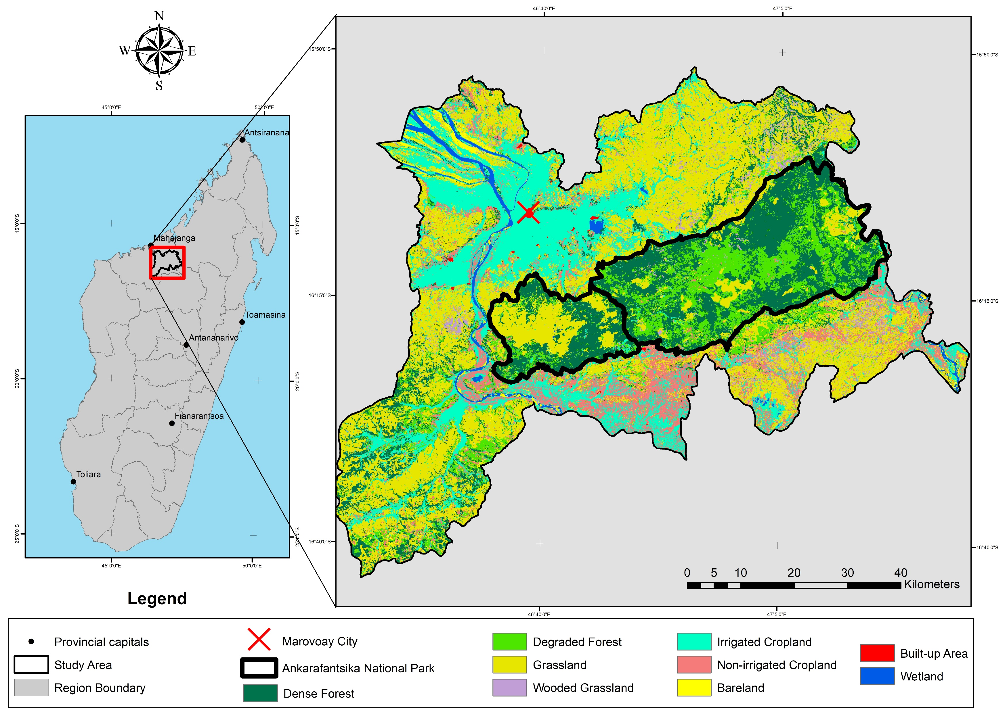
Study area

Slide 7
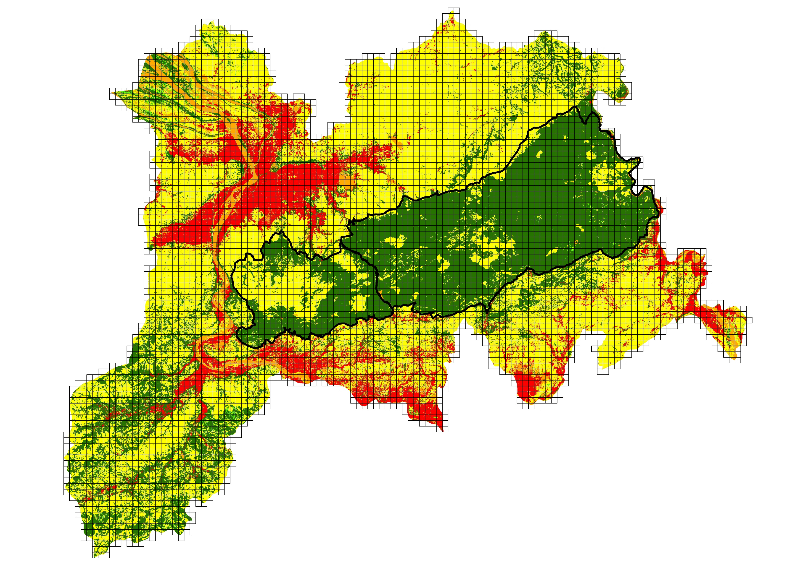
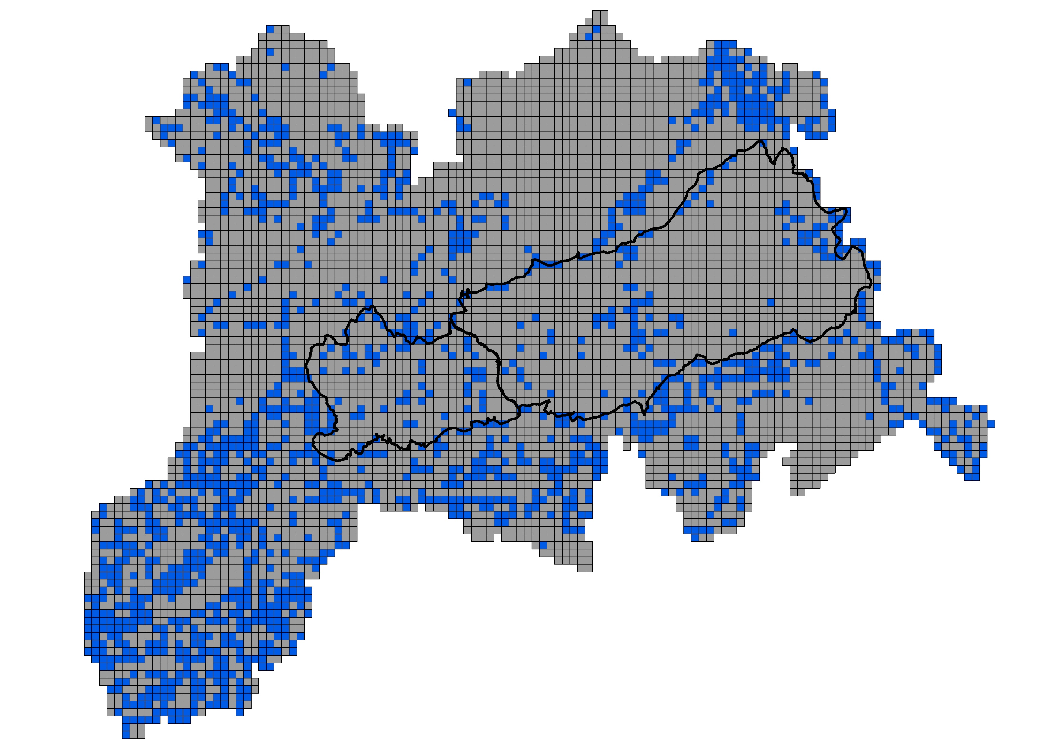
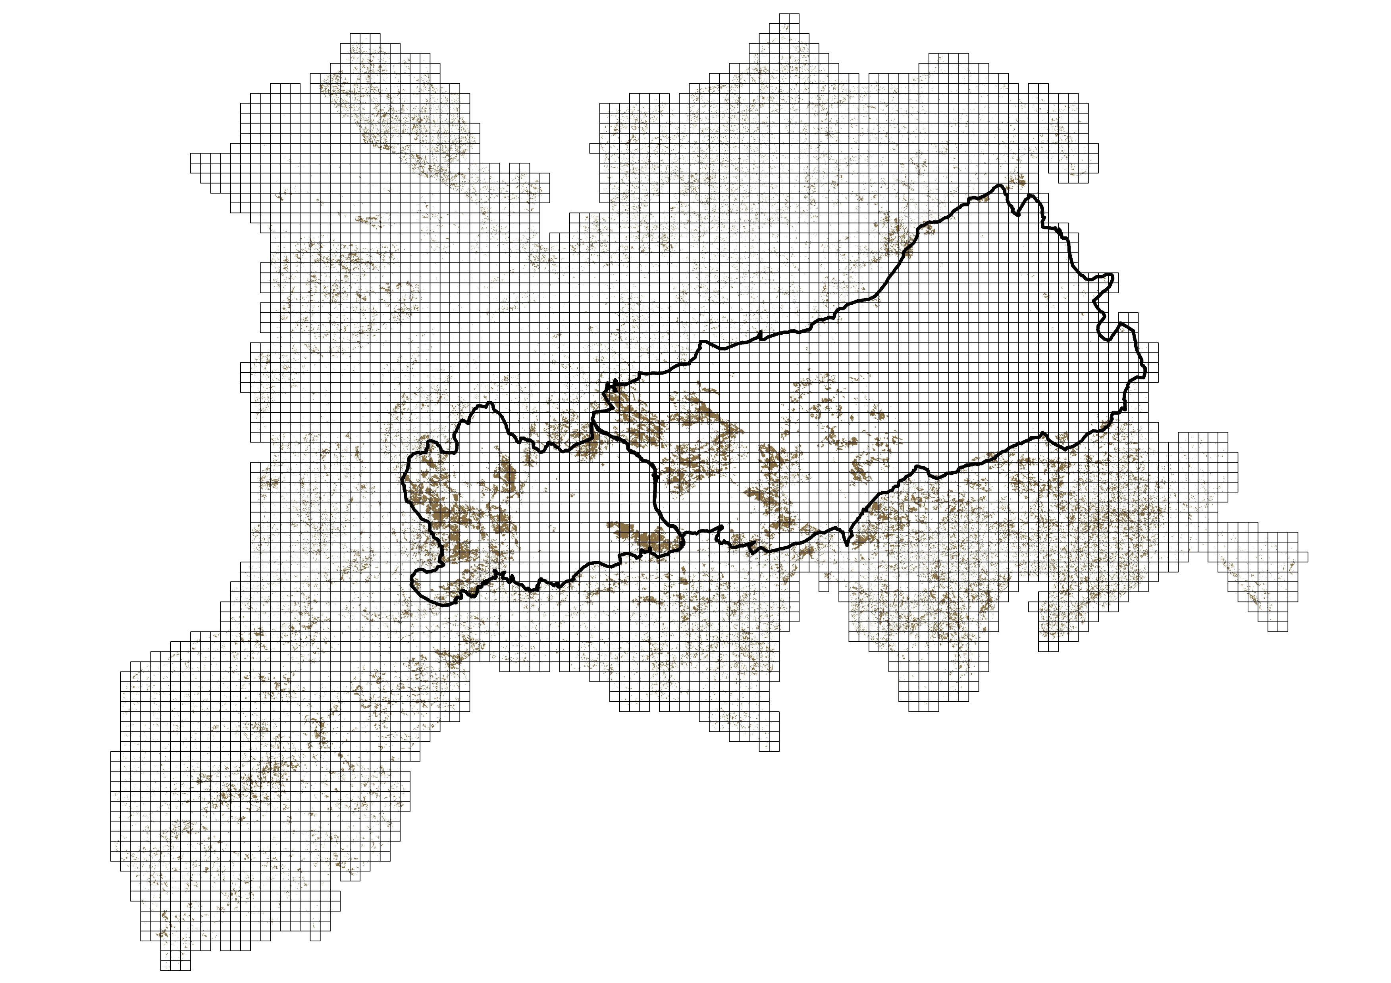
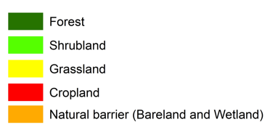
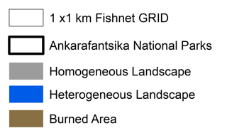
Copernicus Global Land Cover Layers (2016-2019)
ESA WorldCover (2020-2021)
REA-FMRC monthly burnt area data from Sentinel-2 MSI (2016 -2021)

Slide 8
Different types of landscape structure
Landscape structure | Surface (ha)
Forest-Grassland | 474 400
Mixte | 175 700
Grassland-Cropland | 76 000
Forest-Cropland | 41 100
Shrubland-Grassland | 19 800
Forest-Shrubland | 16 200
Shrubland-Cropland | 6 800
Grassland | 1 342 300
Cropland | 1 138 700
Forest | 325 200
Shrubland | 24 800
Heterogeneous
Landscape
Homogeneous
Landscape

Slide 9
Total Burnt Area by landscape structure

Slide 10
Fire effect in each Landscape structure
Landscape structure | Surface (ha) | Burnt Area (ha) | Burnt Extent (%)
Heterogeneous | 811 000 | 44 470 | 5,48
Shrubland-Grassland | 19 800 | 2 403 | 12,14
Forest-Shrubland | 16 200 | 1 614 | 9,96
Forest-Grassland | 474 400 | 31 611 | 6,66
Grassland-Cropland | 76 000 | 4 363 | 5,74
Shrubland-Cropland | 6 800 | 289 | 4,25
Forest-Cropland | 41 100 | 820 | 1,99
Mixte | 175 700 | 3 315 | 1,88
Homogeneous | 2 831 000 | 178 673 | 6,31
Forest | 325 200 | 54 787 | 16,84
Shrubland | 24 800 | 2 295 | 9,25
Grassland | 1 342 300 | 114 936 | 8,56
Cropland | 1 138 700 | 6 655 | 0,58

Slide 11
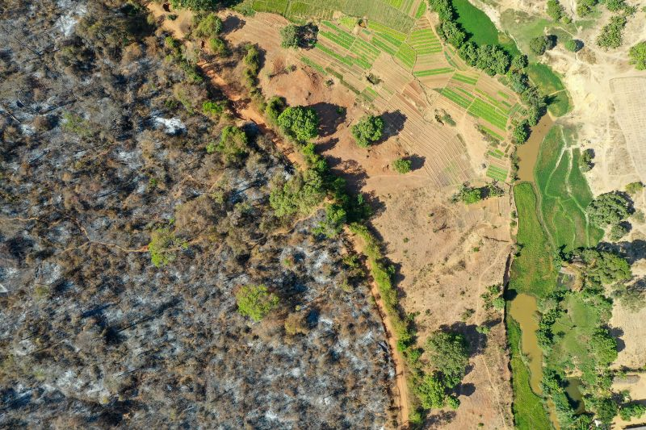
Fire event inside Ankarafantsika National Park in 2021

Slide 12
Conclusion
Large wildfires often occur in homogeneous open (Grassland) and closed (Forest) landscapes
Cropland are less impacted by fires
Mosaic landscape reduces the fuel load, and helps to control and fight fires
Effect of the weather and topography to fire behavior
These results offer new options for fire and land managers in designing and implementing more fire resilient landscapes

Slide 13
Thank You
For Your Attention
www.rfmrc-ea.org
www.llanddev.org

