Slide 1


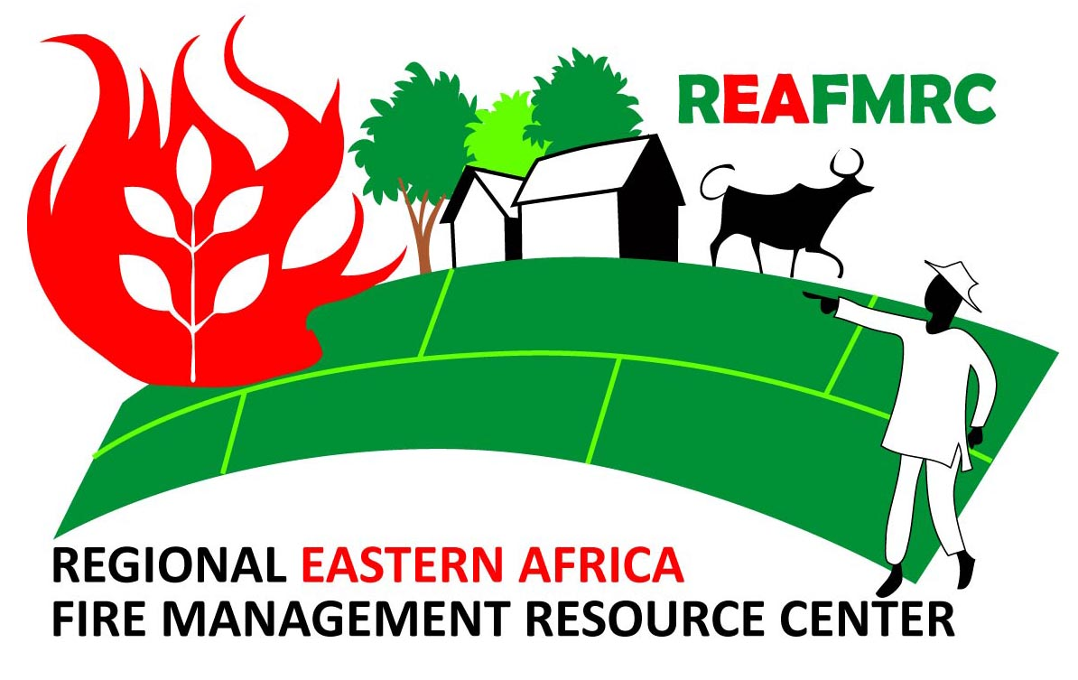

WORKING ON FIRE
20th Anniversary Fire Symposium
Using remote sensing data in supporting wildfire early warning in East-Africa, experiences from the Regional Eastern Africa Fire Monitoring Resource Center (REA-FMRC)
Haritiana Zacharie Rakotoarinivo
Researcher, Land, Landscape and Development Research Lab (LLandDev), Ecole Supérieure des Sciences Agronomiques, Département des Eaux et Forêts (ESSA-Forêts), University of Antananarivo, Antananarivo, Madagascar (haritiana.z@gmail.com)

Slide 2
Major Wildland Fire Issues in East Africa
In recent decades, East Africa has seen a rise in unprecedented large and disastrous wildfires affecting forests, particularly, in many national parks and protected areas (Ethiopia, Kenya, Madagascar, Tanzania, Uganda).
The biodiversity in the region is being threatened by the increasing use of fire, resulting in the gradual transformation of entire landscapes from closed forests to savannas, (e.g. Madagascar).
Increasing frequency, intensity and vulnerability to extreme events, primarily droughts (especially in Somalia) and floods.
According to IGAD Climate Prediction & Applications Centre (ICPAC), projected higher temperatures and extended drought conditions coupled with population growth pressure, are likely to increase occurrence and intensity of wildfires in the region in the future.

Slide 3
Regional Eastern Africa Fire Monitoring Resource Center (REA-FMRC)
REA-FMRC serves countries of East Africa by providing essential scientific and satellite-derived fire data. We promote seamless collaboration among all departments in wildfire monitoring for early warning information on active burning, fire danger and burned area monitoring. In this scope, the REAFMRC will
generate, archive, interpret and disseminate scientific-technical and satellite-derived near-real time and historic data and information on landscape fires.
organize consultations aimed at generating awareness and foster cooperation among decision-makers of all concerned sectors about the importance of fire management at landscape level as a prerequisite for the implementation of national land management and environment policies.
support advanced landscape fire management training courses combined with field practice for professionals working in the institutions with a task in landscape fire management or disaster risk reduction.
support national authorities in reaching out to civil society and their active participation in wildfire prevention and risk reduction, notably at local community level.

Slide 4
Fire Monitoring in East Africa
Development of a specific geoportal first for Madagascar, and now for all the eastern Africa countries in order to share all the available data on active fires, on fire forecasting and monitoring :
Daily fire danger forecast based on the Canadian Fire Weather Index (FWI) System
Near Real-Time (NRT) active fire data (MODIS and VIIRS) provided by the NASA FIRMS (Fire Information for Resource Management System)
Monthly and annually burnt area monitoring by using two spectral indexes (Normalized Burn Ratio, NBR and Burned Area Index for Sentinel-2, BAIS2) from Sentinel-2 images (Tahintsoa et al., 2022).
All of this information is publicly available at www.rfmrc-ea.org geoportal and has been used in Madagascar to catalyze a better understanding of the role of fires in the landscapes by all stakeholders.

Slide 5
Fire Danger Rating System (FDRS) for early warning
Early warning of wildfire is based on fire danger rating.
Standardized system used to assess and communicate the potential risk or danger of wildfires in a particular area.
Objectives of FDRS :
  Fire prevention
  Risk reduction and mitigation
  Planning and execution of fire fighting operations
  Identification of high fire prone areas
  The Canadian Forest Fire Danger Rating System (CFFDRS) is the most popular FDRS :
    relatively simple to use
    modular approach
    can be adapted to a variety of environments : fully or partially used in many countries, including Australia, Indonesia and Malaysia, New Zealand, Argentina, Mexico, Fiji, Spain, Portugal, Sweden, USA, etc.

Slide 6
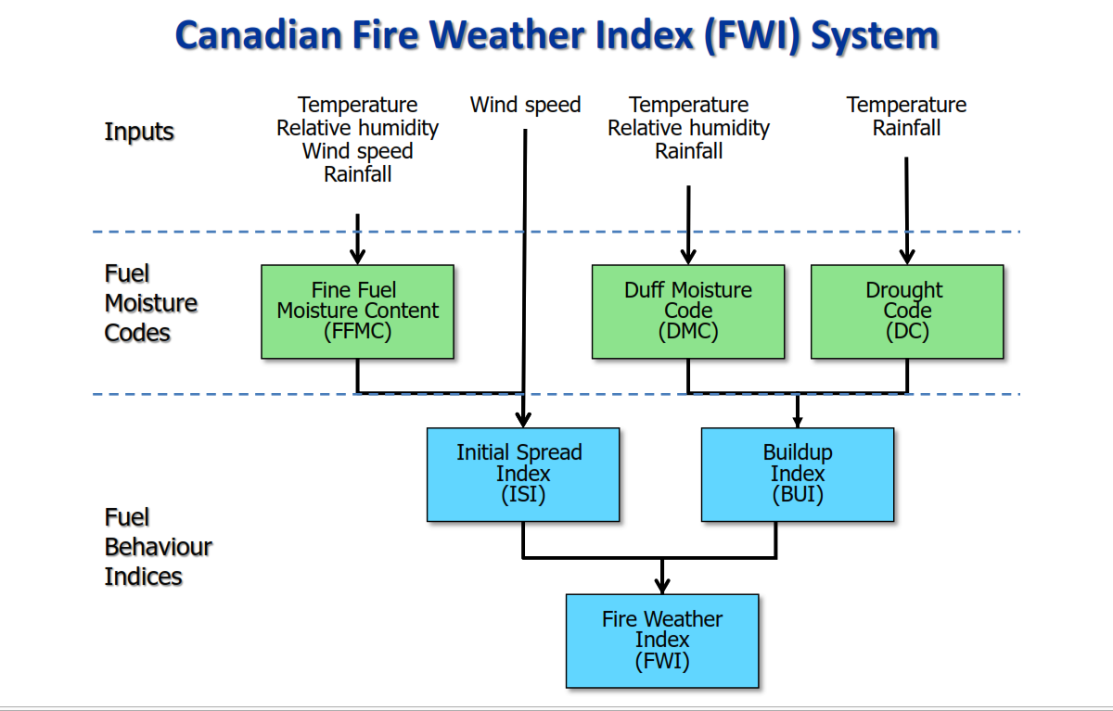
Canadian Forest Fire Danger Rating System (CFFDRS)

Slide 7
Designing Early Warning Systems for East Africa
Limited number and sparse dispersion of weather stations over East Africa
Need information on fire danger index at local level (district, commune, village, etc.)
Advantages of the use of satellite remote sensing data : Provide comprehensive and multi-temporal coverage of large areas in real-time and at frequent intervals, mapping at a regular spatial resolution and cost-effective, integration of Multiple Variables, Historical Analysis.
Limitations of the use of satellite remote sensing data : Do not directly estimate the meteorological parameters, data processing is more complex, data gaps, availability, coverage and cloud cover.

Slide 8

Remotely-sensed Fire Weather Index (FWI) for early warning
Predicts tomorrow fire danger (1-day fire danger forecast) for all the eastern Africa countries : Burundi, Djibouti, Eritrea, Ethiopia, Kenya, Madagascar, Malawi, Mozambique, Rwanda, Somalia, Tanzania, Uganda, Zambia and Zimbabwe.
Calculations done on Google Earth Engine (GEE)
Five Classes : Low – Moderate – Important – Very high – Extreme
Weather data (Inputs) | Remote sensing data
Last and maximum Land Surface Temperature | GCOM-C/SGLI L3 Land Surface Temperature (4 638.3 meters)
Tomorrow minimum Relative humidity | Global Forecast System (GFS) 384-Hour Predicted Atmosphere Data (27 830 meters)
Tomorrow maximum Wind speed
Today 24h Rainfall

Slide 9
Calibration of the Fine Fuel Moisture Code (FFMC)
FFMC measures the moisture content in fine surface fuels, it is well appropriated for predicting fire occurrence

Slide 10
Calibration of the Fire Weather Index (FWI)
Accuracy (%)
Improvement in accuracy every year
Approximatively 80% of total VIIRS active fire located in “Important – Very High – Extreme” Fire Danger Class , mostly “Important – Very High”
Year | 2019 | 2020 | 2021 | 2022
Accuracy | 78,13% | 78,43% | 79,15% | 79,33%

Slide 11
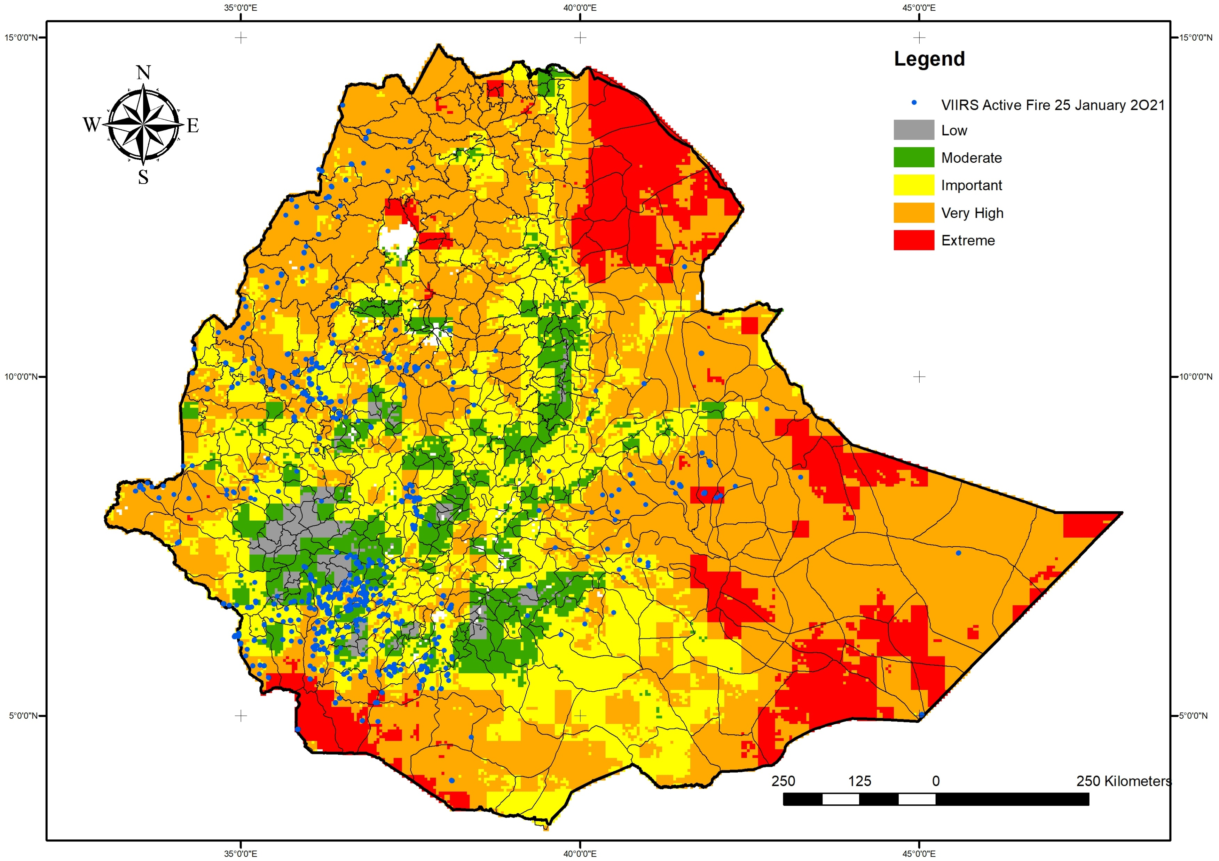
Ethiopia Fire weather Index (FWI) 25 January 2021

Slide 12
Application
Early warning has been done operationally for three years in Madagascar : communication to stakeholders and the public via social media, WhatsApp and the geoportal, and to the local community via radio
Identification of high prone fires areas and implementation of 65 km agricultural fuelbreaks, mainly around Ankarafantsika National Park in northern Madagascar between 2021 and 2022 : established in generally open landscapes dominated by grassy savanna to limit the spread of fires and create an additional 615 ha of farmland for crop production to limit further slash-and-burn activities in the national park and so further reduce the potential for future fire ignitions (Rakoto Ratsimba et al., 2022)
Data for all Eastern African countries are available from January 2019 to today.

Slide 13
Challenges, future works, …
Refinement of remotely-sensed FWI algorithm by determining the suitable empirical parameters
Integration of some geographical parameters (DEM, land cover, etc.) to improve FWI and model fire spread to enhance our ability to predict and respond to the behavior and dangers of wildfire
Develop a communication plan so early warning information gets to the local community level
Policy support and international cooperation
Scientific research on calibration and use of the FWI system components and climate change effect on FWI value and fire occurrence and behavior

Slide 14
Thanks for Your Attention
REFERENCES
Rakoto Ratsimba H, Andriamiharimanana, JN, Braun M. and Goldammer, JG. 2022. Agricultural fuelbreaks in sustainable fire-resilient landscapes in Madagascar. DOI: https://doi.org/10.55515/PJMX6791
Tahintsoa GH, Raherinjatovoarison D, Rakotoarinivo HZ, Ratsimandresy RN and Rakoto Ratsimba H. 2022. Using satellite images to monitor burned areas in Madagascar. DOI: https://doi.org/10.55515/FIOP8254
Thapa S, Chitale VS, Pradhan S, Shakya B, Sharma S, Regmi S, Bajracharya S, Adhikari S and Dangol GS. 2021. Forest Fire Detection and Monitoring. In: Bajracharya, B., Thapa, R.B., Matin, M.A. (eds) Earth Observation Science and Applications for Risk Reduction and Enhanced Resilience in Hindu Kush Himalaya Region. Springer, Cham. https://doi.org/10.1007/978-3-030-73569-2_8
www.rfmrc-ea.org
www.llanddev.org

