Slide 1


Working on Fire 20th Anniversary Fire Symposium
Free State Umbrella FPA
Coordinating Efforts for Effective
Wildland Fire Management

Slide 2
Implementing ICS as a Critical
Component of Response and Management of Wildfire Emergencies in the Free State .
Free State Umbrella FPA
Coordinating Efforts for Effective
Wildland Fire Management

Slide 3
Provincial Background
Surface Area: 129 464 km² (12946400h)
Population Density: 22.8/km² ( 2nd lowest in the country)
Biomes:
86.7% Grassland
6.47% Nama Karoo
6.49% Savanna
Land Use:
91.9% Agricultural
Cultivated Land: 32000 km² (24.7% total surface area)
Grazing/Natural veld 87000 km2 (67.2% total surface area)

Slide 4
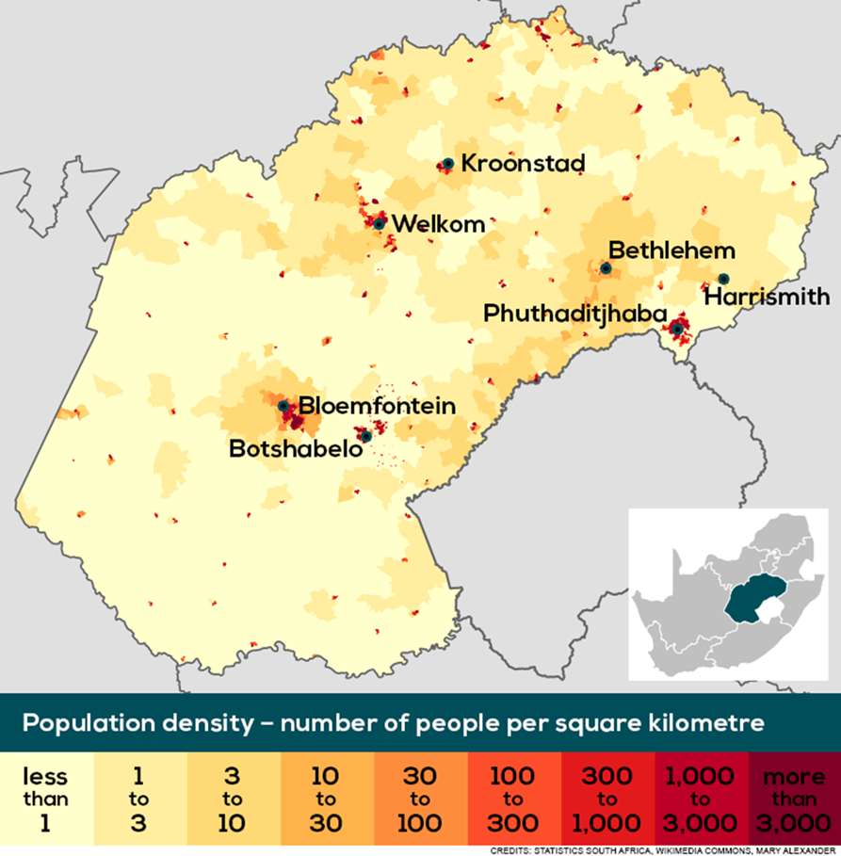

Slide 5
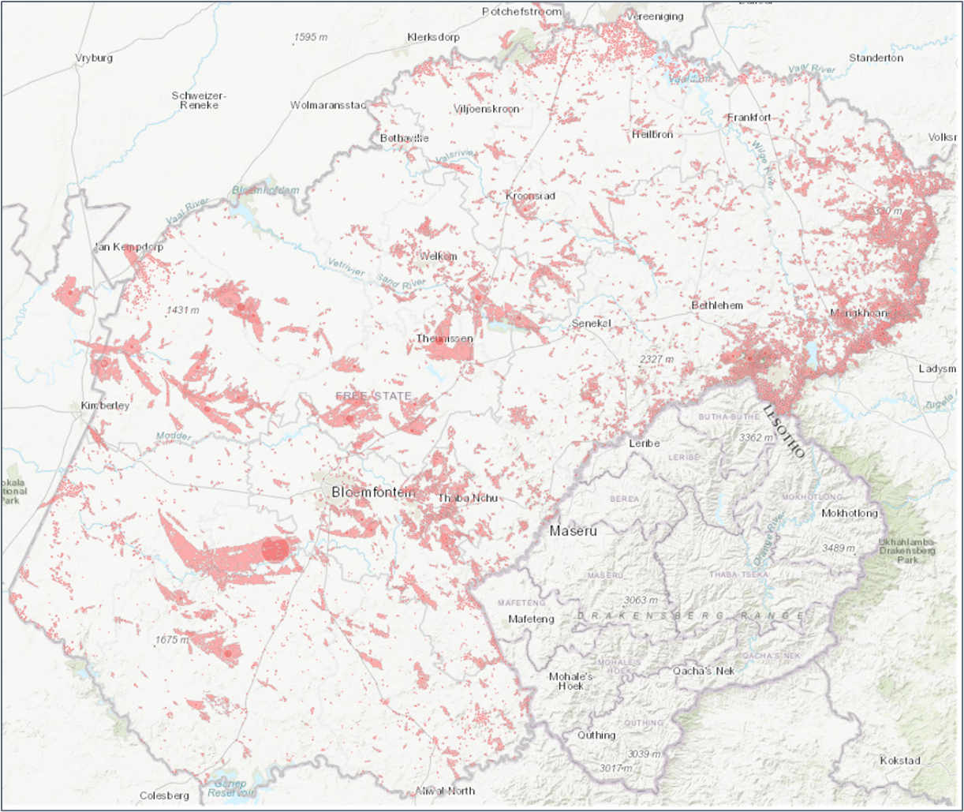

Slide 6
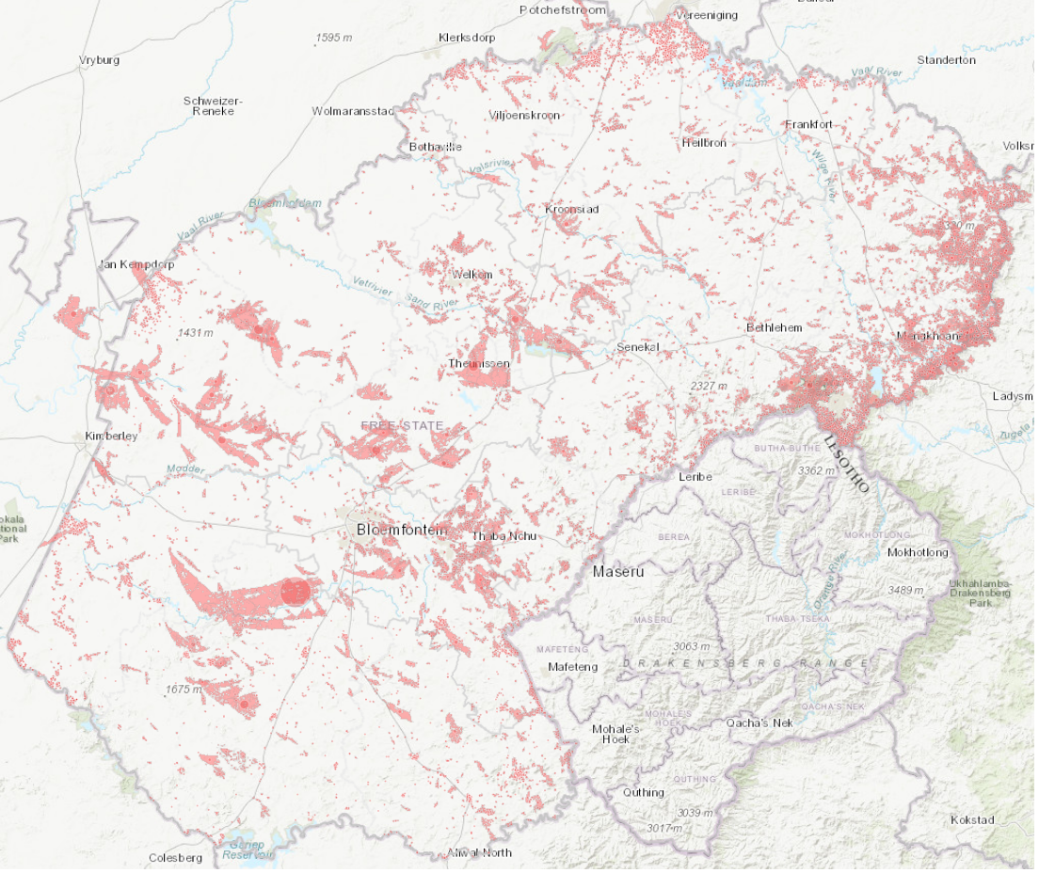
FREE STATE PROVINCE
2019 – 2023
FIRE SEASONS
53378
Fire Incidents
2308694
Hectares Burnt

Slide 7
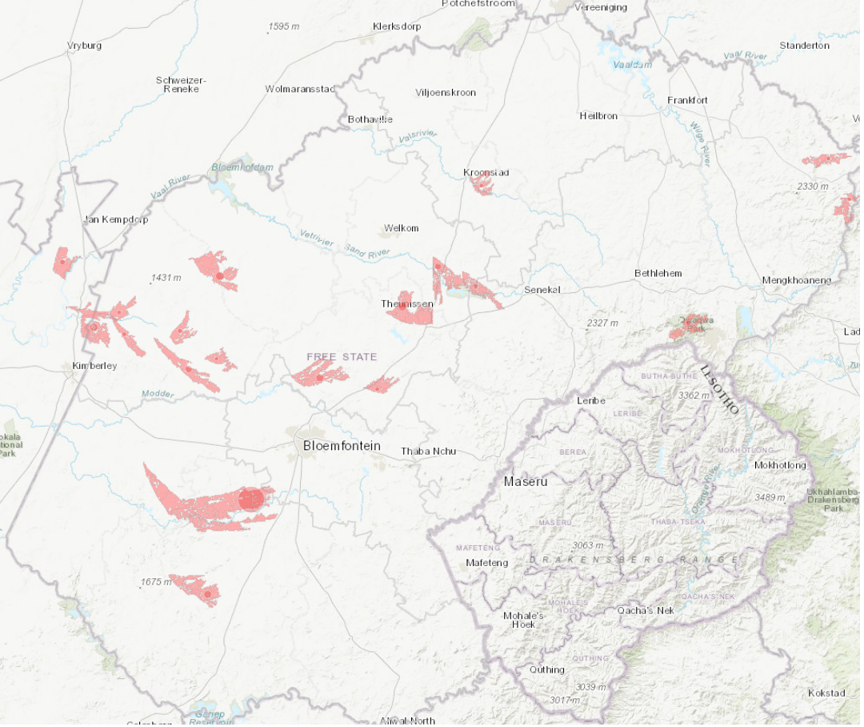
FREE STATE PROVINCE
2019 – 2023
FIRE SEASONS
19 Large
Fire Incidents
401429.64
Hectares Burnt

Slide 8
Operational Requirements
Standardization
Planning and Organizational Structure
Communication
Command and Control
Manageable Span of Control
Responsive / Modular Structure
Resource Management
Accountability

Slide 9
Free State Province
Disaster Management
&
Emergency Services
Fire Services
Institutional Deterioration
Chronically underfunded
Lack of equipment and personnel
Disaster Management
Underdeveloped Organizational Structure

Slide 10
Free State Provincial Wildfire Management
Framework
Practical Implementation of Integrated Wildfire Management using ICS principles and structure.

Slide 11
Free State Provincial Wildfire Management
Framework
Disaster Management Framework Alignment
ICS Streamlined
Standard Operational Procedures
Multijurisdictional Mandates
Effective Communication
  Information Sharing
  Intelligence Gathering
Escalation Procedures
Command and Control
Resource Management
Recording and Reporting
Accountability

Slide 12
Organogram: Provincial Wildfire Management Framework
PWAF
Xhariep FPA
Lejweleputswa FPA
MAFPA
FEDAFPA
PDMC
Imperani FPA
Bethlehem FPA
NEFSFPA
FMA
FMA
FMA
Fire Sector
Fire Sector
Fire Sector
Fire Sector
Fire Sector
Fire Sector
Fire Sector
Fire Sector
Fire Sector
FSUFPA
ProFSAC

Slide 13
Provincial Wildfire Incident Response
Task
Team
Establish Incident Specific Virtual EOC / JOC
Incident Management Team
  Incident Management Post
  Staging Area
Fire Fighting Resources
Pre-configured WoF Task Team
Structured FPA Volunteer Strike Teams

Slide 14
ICS, the Critical Component Enabling Effective
Wildfire Incident Response
Free State Umbrella FPA
Coordinating Efforts for Effective
Wildland Fire Management

