Slide 1

Aon South Africa
Business Continuity Management
9 November 2023
Presented by Nicolene Olivier

Slide 2

NICOLENE
OLIVIER
Certified Business Continuity Practitioner

Slide 3
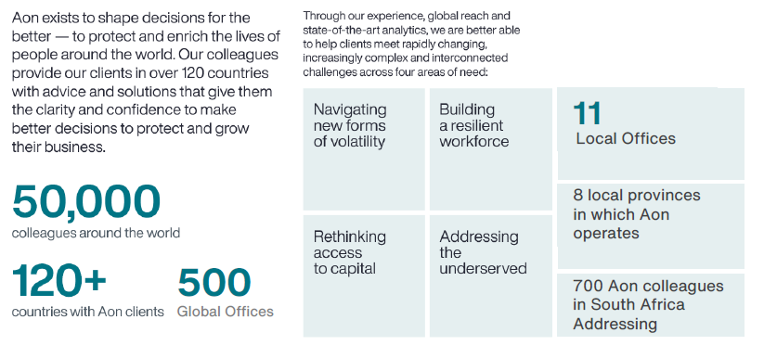
Aon is in the business of better decisions

Slide 4
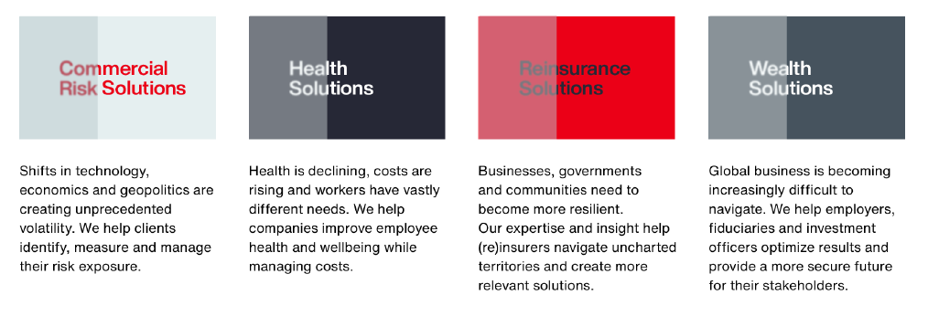
Solution lines that enable our client to make better decisions
  Aon’s experience, global reach and state-of-the art analytics mean that we are better able to deliver the insights and advice that helps today’s companies protect and grow their organisations. The end benefits of all that we di is enabling our clients to make better decisions.

Slide 5

What is Business Continuity Management
Risk and Resilience Lifecycle
RECOVER
ANTICIPATE
RECOVER
RESPOND
WITHSTAND

Slide 6
Response Structure
Key Components
Emergency Response
The immediate response to an incident/disaster, where actions need to be taken swiftly to safeguard life, limit injuries and prevent escalation of physical damage to assets.
Crisis Management
A senior management function aimed at strategic decision-making and provision of leadership/direction for incident/disaster management relating to Reputation, Brand/Image, Stakeholder’s Confidence and Media.
Business Continuity
The process of recovering/continuing urgent and critical business processes, within the predetermined recovery time objective (RTO), to minimize the impact on the organization.
IT Disaster Recovery
Plans and processes designed to restore information technology services, which support the business within the acceptable recovery time objective (RTO).

Slide 7
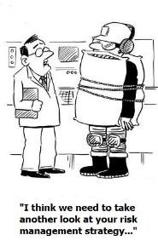
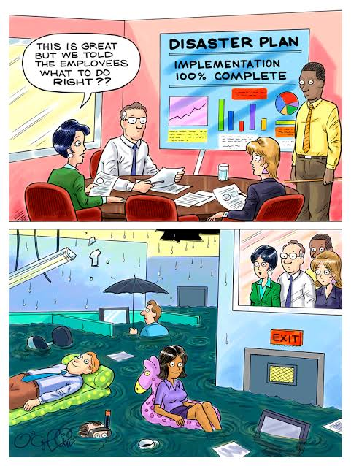
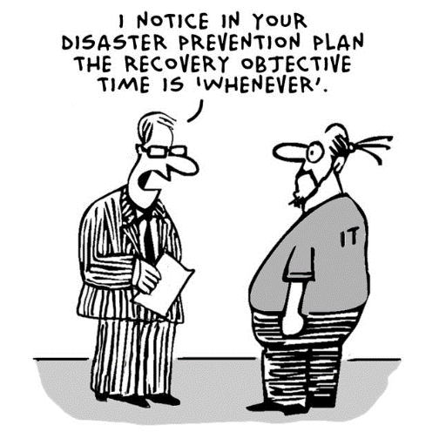
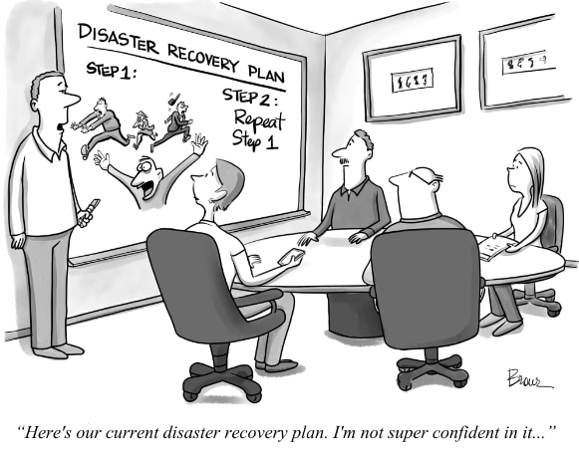
Why is it important?
  Document the information required to recover and resume operations
  Provide guidance to manage the incident.
  Not Scenario Specific

Slide 8







What would you find in a Business Continuity Plan
Human Resources
Facilities
Applications / Data
3rd Party / Service Provider
Specialised Equipment
Records & Documents
Utilities
Succession Planning
Shift Adjustment
Temporary Labour
Alternative Site
Remote Work
Geographical Redundancy
IT Disaster Recovery
Data Backup
Local Resilience
Alternative Suppliers
SLA’s/Contracts
In-sourcing
Critical Spares
Dual Sourcing
Manual Alternatives
Store in fireproof safe
Keep off-site
Backup power Arrangement
Water Tanks/ Boreholes
Purpose, Scope and Assumptions
Response Structure
Step-by-step actions to following an invocation of a plan
Key contact details

Slide 9

Thank You

