Slide 1


Fleet Management:
Key component of IFM

Slide 2
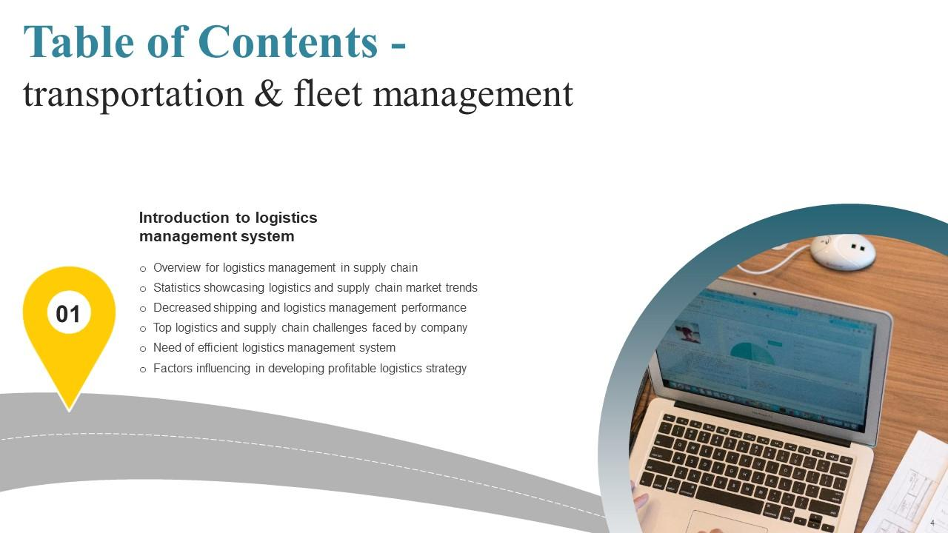

FLEET MANAGEMENT
A key component of
Integrated Fire Management and the application of
advance technology

Slide 3
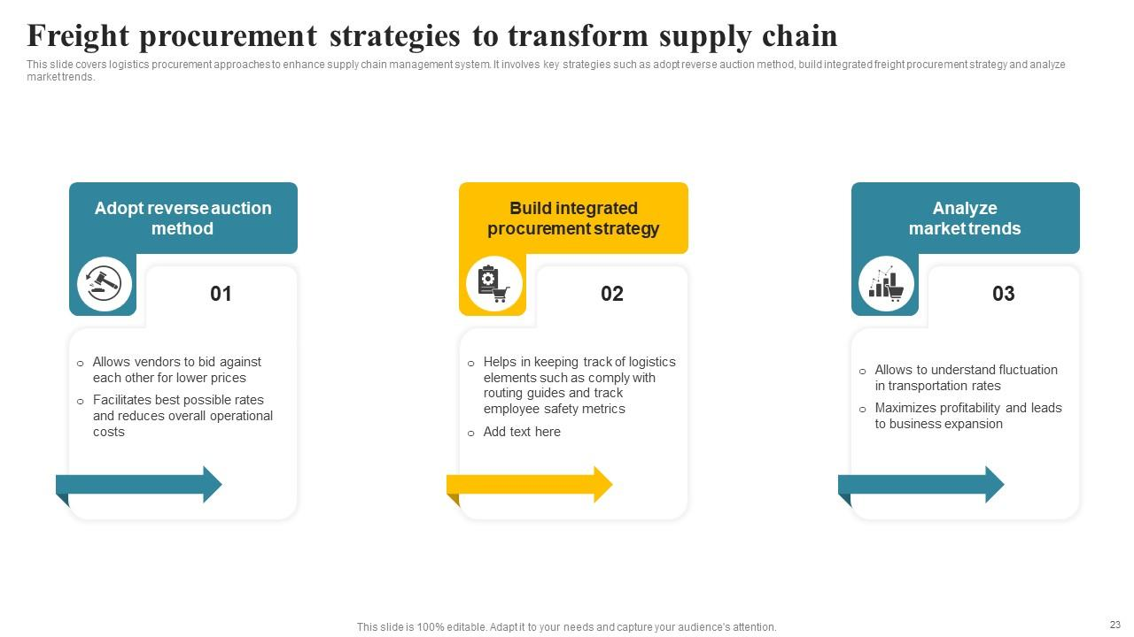



Integrated Fire Management embodies a comprehensive approach to wildfire management:
PREVENTION
MITIGATION
RESPONSE
These elements plays a crucial role in achieving these objectives.

Slide 4
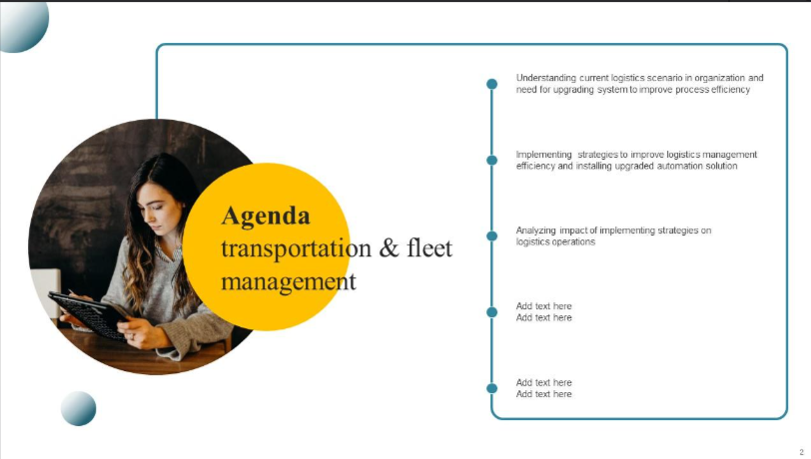
For the past 20 years we have managed and maintained over 620 vehicles in both the WoF and non-WoF fleets
Ensure safe transportation of thousands of staff to/from 217 bases over 2 decades.
Fleet management and
advanced technology
contributes to
IFM:
Our DEEP COMMITMENT TO ROAD SAFETY – is evident our track record
The smart use of technology enables safer environment
Correct resource, response time, maintenance, communication and monitoring

Slide 5
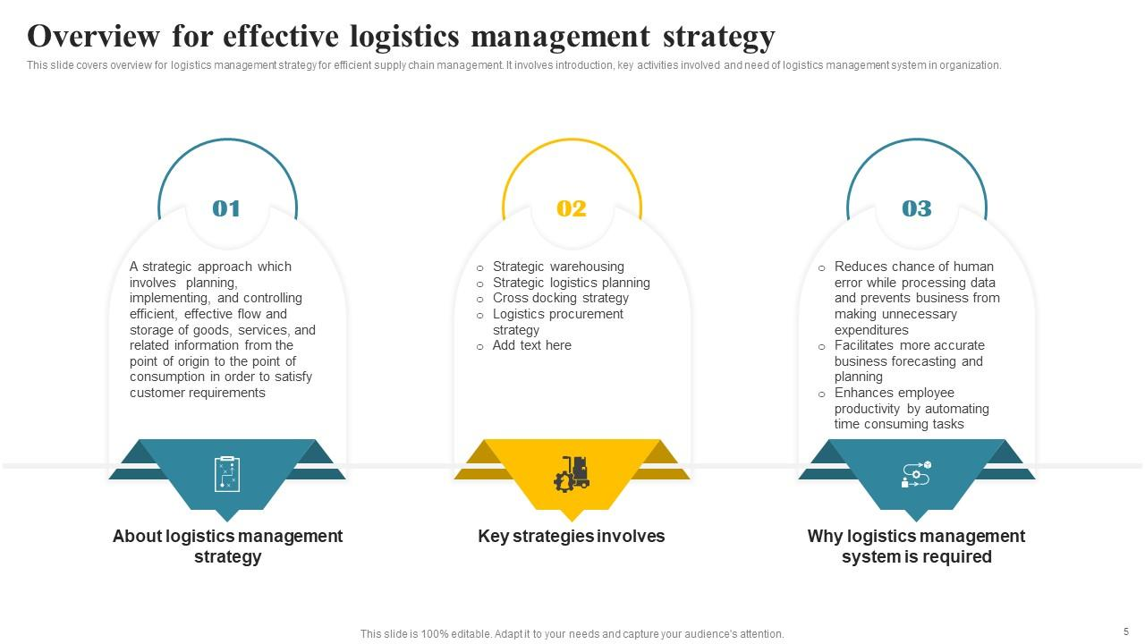
?
Process
What do we offer?
Fleet management entails the procurement, strategic coordination, and supervision of vehicles, equipment, and personnel. Its purpose is to ensure the efficient deployment, proactive preventative maintenance and general maintenance.
We prioritise safety through robust systems and measures.
We offer a holistic fleet management solution, including risk management, asset management, and cost minimisation, with a focus on driver behaviour. We provide flexible options and value-added products tailored to your unique needs, driven by expertise and technology. We cater to a wide range of client needs and provide flexible options, including operational lease options.
Additionally, we offer driver behaviour management tools linked to onboard cameras, tracking systems, insurance solutions, and fuel management, all tailored to meet the unique requirements of each client. Our distinctive fleet management solutions combine expertise, experience, and cutting-edge technology to optimise fleet operations.
Safety
Fleet management
Risk management
Asset management
Cost minimisation
Driver behaviour
management tools:
  Onboard cameras
  Tracking systems
  Insurance solutions
  Fuel management
Procurement
Strategic coordination
Equipment
Personnel
PURPOSE: Ensure efficient deployment, proactive preventative maintenance and general maintenance
Distinctive fleet management solutions | combine expertise | experience | cutting-edge technology
OPTIMISE
FLEET OPERATIONS
to optimise fleet operations.

Slide 6
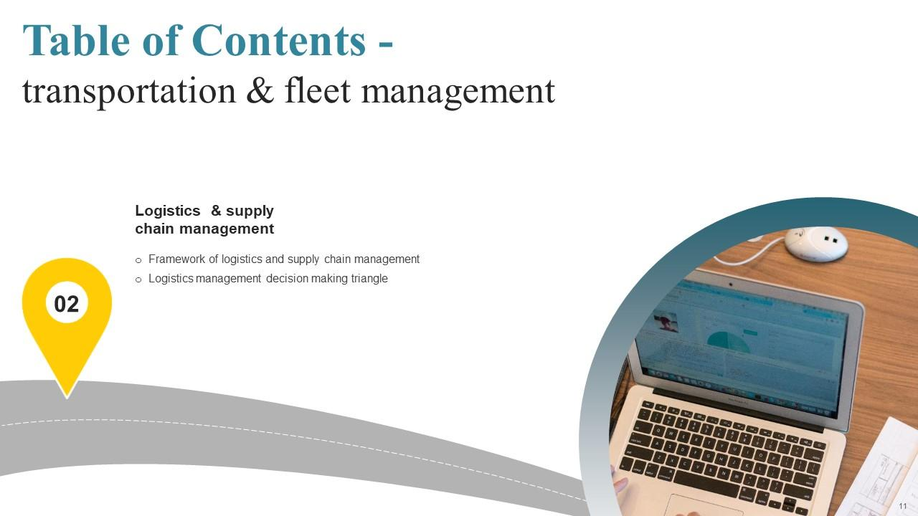
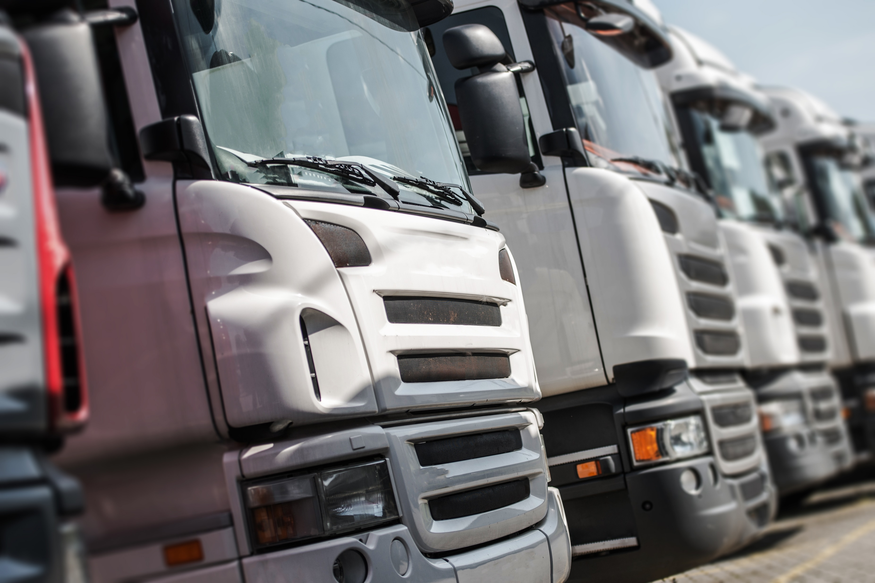
Integrated Fire Management (IFM): cornerstone of firefighting
Holistic approach to wildfire
prevention, mitigation, and
response.

Slide 7
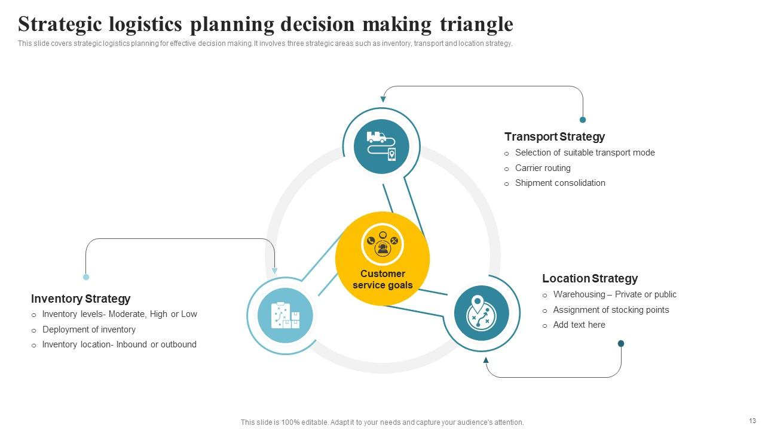
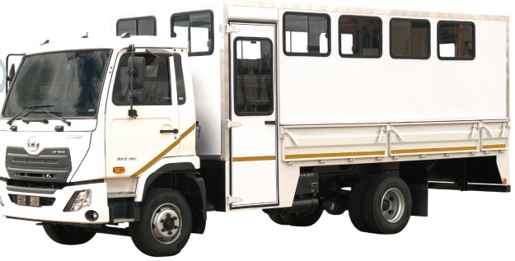
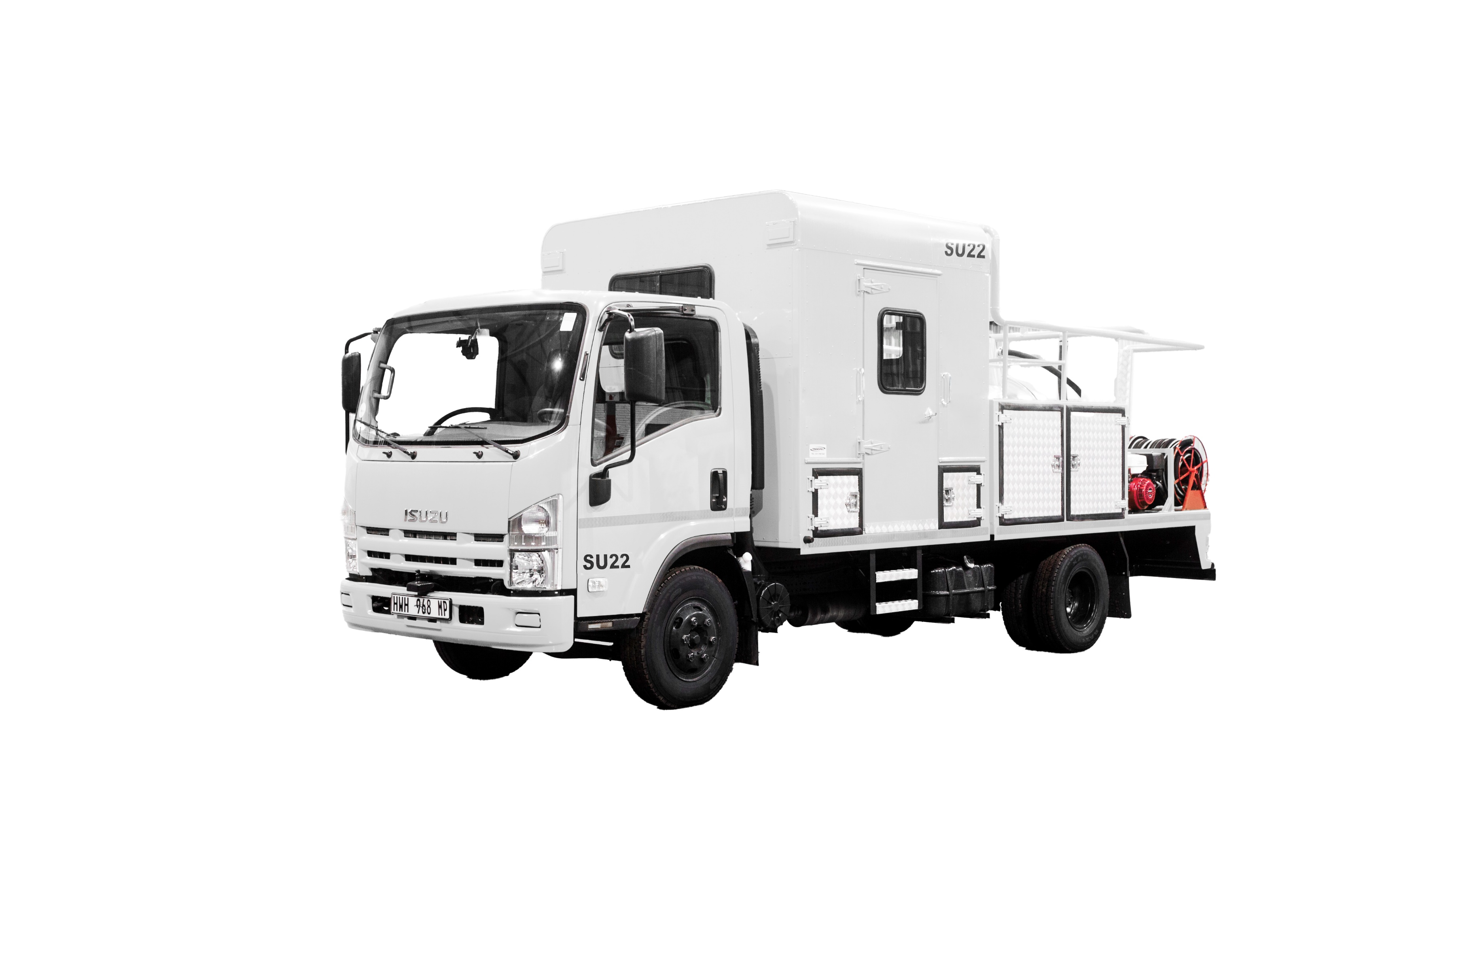
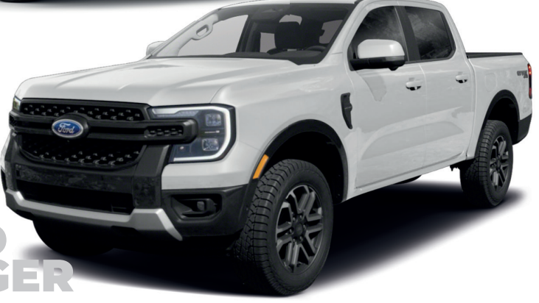
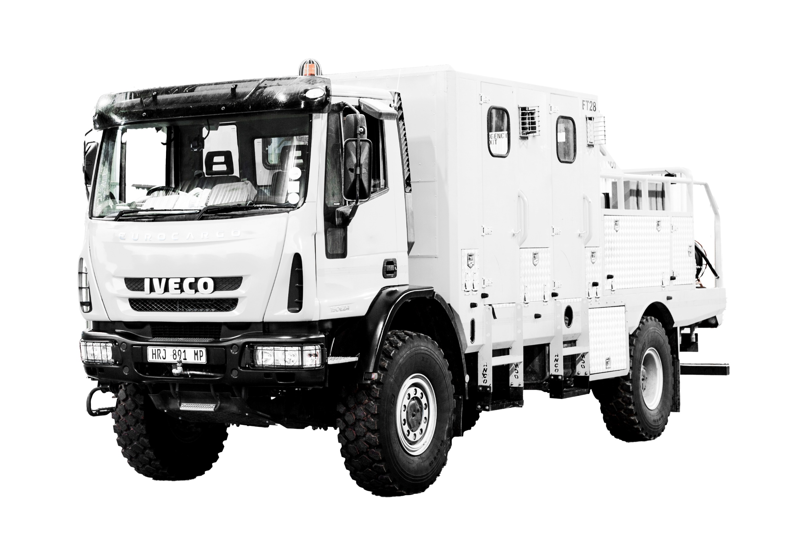

WHY
is fleet management so imperative in this context?
PROCUREMENT of specialised and
fit-for-purpose equipment is VITAL.
BUSES:
Description: Single cab forward-facing bus configuration.
Towbar and trailer
Application: Participant transport between activities
LDVS/BAKKIES:
Description: Double Cab 4x4, LDV with Cattle rails/canopy with 200 liter bakkie sakkie.
Application: Movement of provincial management to complete managerial tasks.
Firefighting
FIRE TRUCKS | STRIKE UNITS
Description: Single cab 15 ton 4x4 truck, 23 person capacity. 2 500 liter firefighting equipment.
Application: Large ff unit for WoF deployment activities
Description: Single cab 2x4 truck , 12 person capacity. 1 500 liter firefighting equipment.
Application: Medium strike-unit for WoF strike unit deployment activities

Slide 8
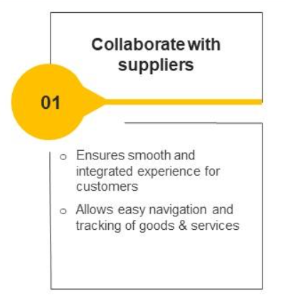
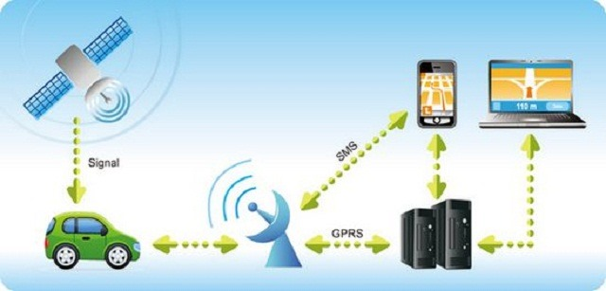
of response – PARAMOUNT!
SPEED
ADVANCED TECHNOLOGY
Every second counts!
1
Reduces response times
Dispatch and coordination centers
GPS vehicle tracking systems
Monitor real-time location
Enable rapid deployment

Slide 9
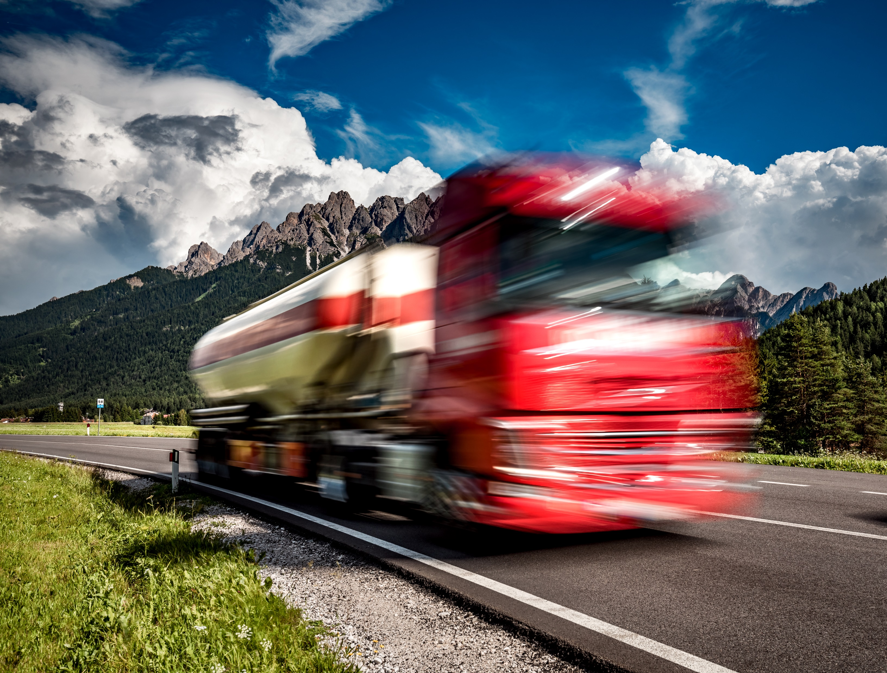
is KEY!
SAFETY
SAFETY IS A CRITICAL ASPECT
Vehicles equipped with safety features
2
Airbags | stability control systems | advanced driver assistance systems | telematics.
Enhance convenience | protect drivers | reduce accidents..
Strict maintenance schedules reduces downtime, minimizes breakdowns.
Allocation of resources essential for effective response.

Slide 10

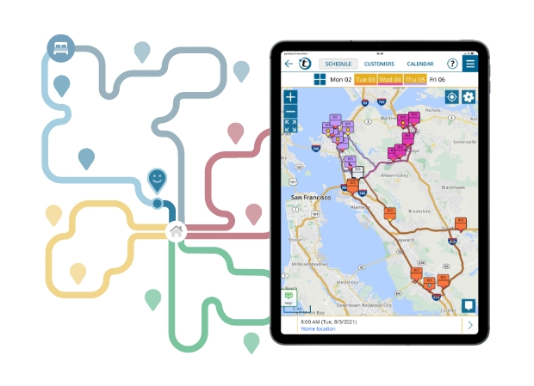
Analyze
DATA
Utilization of Advanced Technology
Provides tools to collect/analyze data:
3
Data on vehicle usage, driver behaviour, and fuel consumption.
When leveraged effectively, data allows for informed decisions about resource allocation, route planning, other critical aspects of fleet management.
Leads to cost savings / improved efficiency

Slide 11
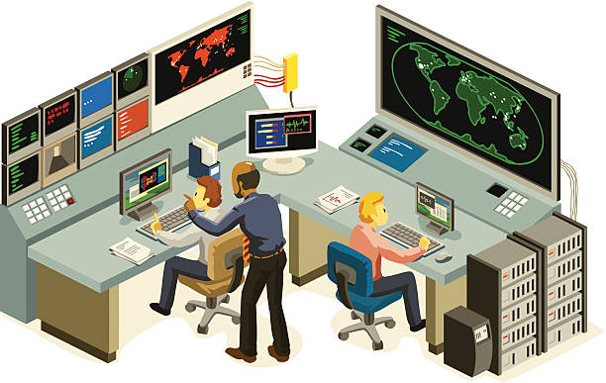
Training and
MONITORING
INVALUABLE
Training and Monitoring
4
Joint Management Centre (JMC) employs latest technology - monitor driver behaviour | promoting safer driving practices.
Data insights inform training programs enhance driver skills and safety.
Monitor / report violations of policies / standard operating protocols - ensure corrective actions are taken.

Slide 12
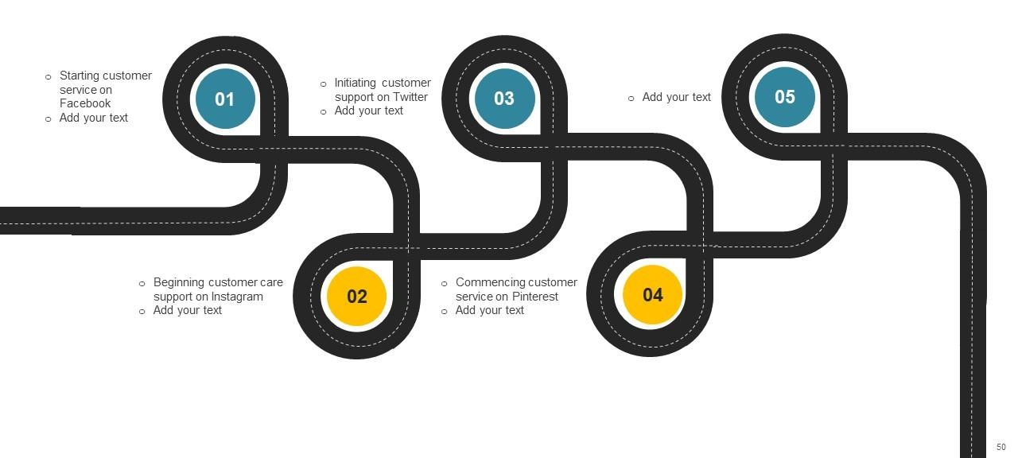
In a time when wildfires are increasingly severe and frequent, the role of technology in fleet management is more vital than ever.
Conclusion
Fleet management and advanced technology application for vehicles and drivers are
and enhance overall efficiency in combating wildfires.
They ensure the
safety of firefighting personnel,
critical components of Integrated Fire Management,
improve response times

Slide 13


THANK YOU

